Slide 1
Intelligent Process Automation in Audit
Abigail Zhang
Continuous Auditing & Reporting Lab
Rutgers Business School
44th WCARS
03/22/19
Notes:
I am Abigail Zhang from Rutgers Business School. The previous presentations are about RPA, and I am presenting my work on Intelligent Process Automation in Audit.

Slide 2
Overview
Motivation and Introduction
IPA ecosystem in audit
Three frameworks of IPA in audit
“Auditor-in-the-loop” IPA ecosystem
Audit workflow driven by IPA
Implementation framework
IPA facilitates Continuous Audit
Conclusion

Slide 3
Motivation
Audit automation is both the necessary and sufficient condition for continuous audit (M Alles, Kogan, and Vasarhelyi, 2008).
Today’s audit automation is mainly about isolated audit task automation
digitizing working papers and their management
using Microsoft Office Software and CASEWARE
using audit software (e.g. IDEA and ACL) to perform certain audit testing, and using statistics software (e.g. STATA and R) to run regressions.
However, audit needs process automation to enhance efficiency and effectiveness.
Little literature explicitly study audit automation from the workflow point of view

Slide 4
Research Objectives and Contributions
Formalizes the theories of audit process automation and the technologies that can achieve it, with an emphasis on Intelligent Process Automation (IPA).
Constructs theoretical frameworks of IPA in audit to lend guidance to the audit profession and to stimulate other academic research in this area.
Proposes that IPA can achieve flexible and scalable audit process automation, could solve the independence issue of CA, and facilitate CA in the external audit.

Slide 5
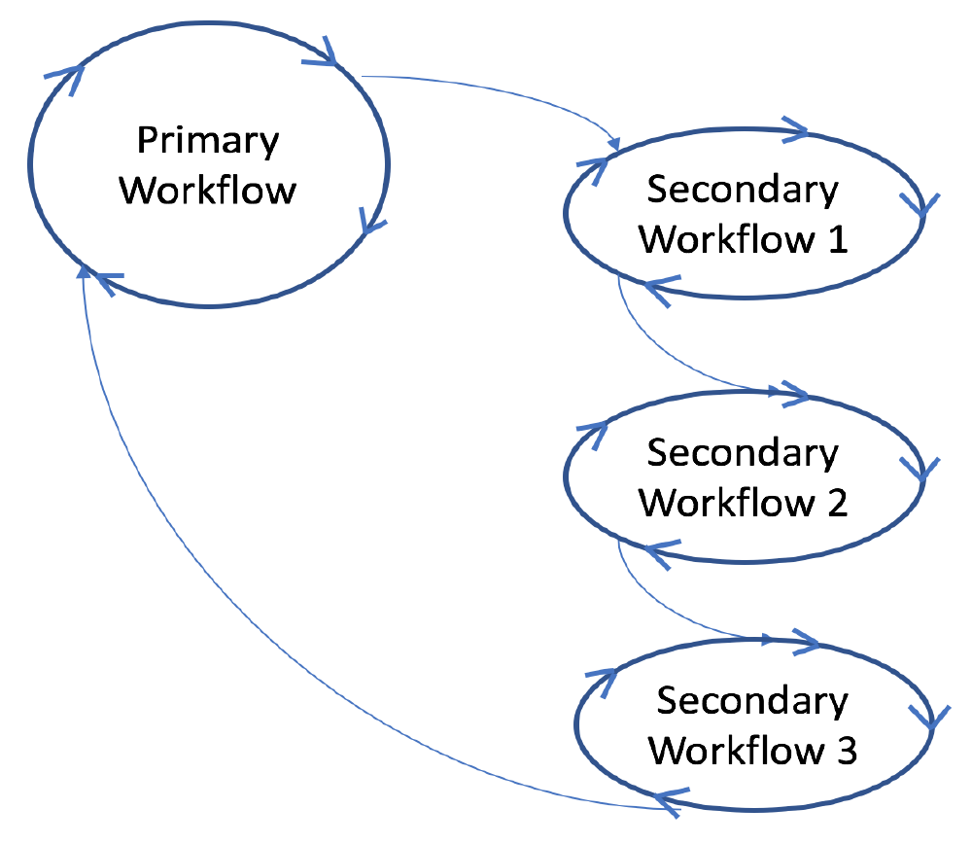
Introduction
A network of workflows (Adapted from Cichocki et al., 2012)

Slide 6
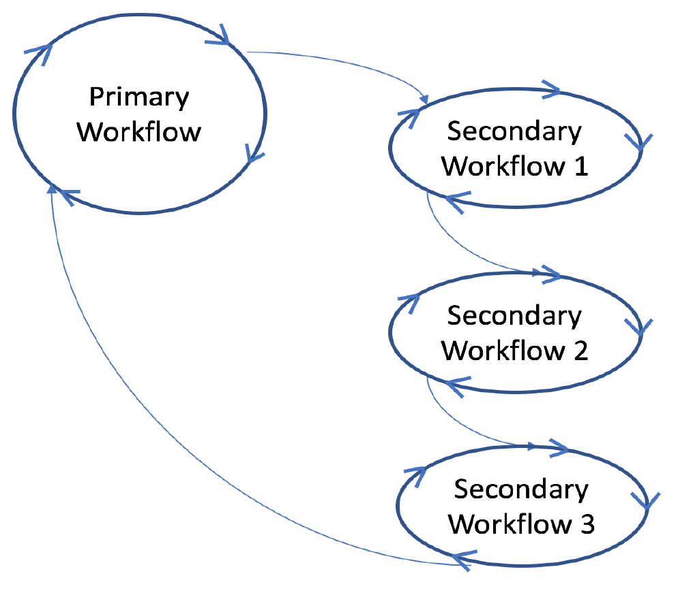
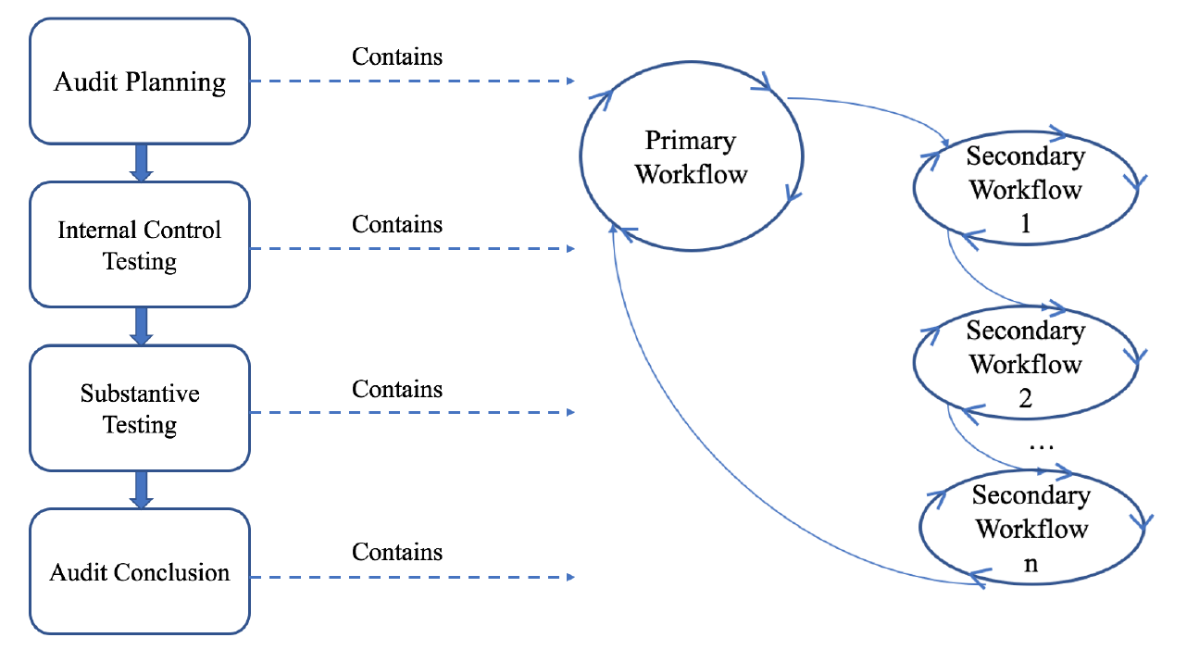
Introduction
The Audit Workflow
Notes:
There are four major phases in an audit engagement. I propose that each audit phase actually contains a network of workflows, and together form an audit workflow. For example…

Slide 7
Introduction
Process Automation
Pre-defined Process Automation (PPA): the patterns of the process are pre-defined by human.
Robotic Process Automation (RPA): run application software in the same way that a person works with that software.
Intelligent Process Automation (IPA): the patterns of the process can be learned and predicted by AI, and then recommended to human.
RPA
This paper constructs theoretical frameworks of IPA in audit to lend guidance to the audit profession and to stimulate other academic research in this area.
PPA
IPA
Notes:
In workflow, aka process automation, we need process automation. I define the process automation that need pre-defined instructions as PPA. And I think that RPA falls within the set of PPA because,,, PRA is just a new way to facilitate PPA, however it is unique because it can interact with systems from the user interface level. From our RPA projects with some CPA firms, we find that the amount of work to program pre-defined route could be humongous when different combinations of situations becomes large. So RPA, or in general PPA is not flexible when new instance appears, and it cannot …And I propose that IPA could be the future process automation in audit because …

Slide 8
IPA Ecosystem in Audit
IPA Ecosystem
RPA
Artificial intelligence
Cognitive computing
Other technologies
Machine learning
Computer vision
Virtual agent
NLP/
NLG
Others
Data analytics
Drones
Smart contracts
Blockchain
IoT
Others
Notes:
IPA in my view, is an ecosystem that contains RPA, AI and other technologies, to achieve flexible, scalable, and intelligent process automation. Different parts are orchestrated to achieve this intelligent and flexible process automation.

Slide 9
IPA Ecosystem in Audit
IPA Ecosystem
RPA
Artificial intelligence
Cognitive computing
Other technologies
Machine learning
Computer vision
Virtual agent
NLP/
NLG
Others
Data analytics
Drones
Smart contracts
Blockchain
IoT
Others
Notes:
IPA in my view, is an ecosystem that contains RPA, AI and other technologies, to achieve flexible, scalable, and intelligent process automation. Different parts are orchestrated to achieve this intelligent and flexible process automation.

Slide 10
IPA Ecosystem in Audit
IPA Ecosystem
RPA
Artificial intelligence
Cognitive computing
Other technologies
Machine learning
Computer vision
Virtual agent
NLP/
NLG
Others
Data analytics
Drones
Smart contracts
Blockchain
IoT
Others
Notes:
IPA in my view, is an ecosystem that contains RPA, AI and other technologies, to achieve flexible, scalable, and intelligent process automation. Different parts are orchestrated to achieve this intelligent and flexible process automation.

Slide 11
IPA Ecosystem in Audit
IPA Ecosystem
RPA
Artificial intelligence
Cognitive computing
Other technologies
Machine learning
Computer vision
Virtual agent
NLP/
NLG
Others
Data analytics
Drones
Smart contracts
Blockchain
IoT
Others
Notes:
IPA in my view, is an ecosystem that contains RPA, AI and other technologies, to achieve flexible, scalable, and intelligent process automation. Different parts are orchestrated to achieve this intelligent and flexible process automation.

Slide 12
“Think-Feel-Do” loop of IPA
AI and cognitive technologies
Human
Think
Drones, NLP, IoT, etc.
PPA/RPA
Feel
Do
Notes:
In inventory testing.
Based on the counted number, machine learning predict.
Unlike RPA, which can only execute pre-programed procedures, IPA can “sense,” “think” and “act.” The data and information “sensed” by …will be forwarded to the thinking part. In thinking, when the AI and cc are not able to deal with certain tasks, it will forward them to a human and learn from what the human does. Then the thinking part will give order to the acting part, where the RPA will … If necessary, the sensing part will again obtain data from what’s been executed from acting, closing the loop and starting the circle again.

Slide 13
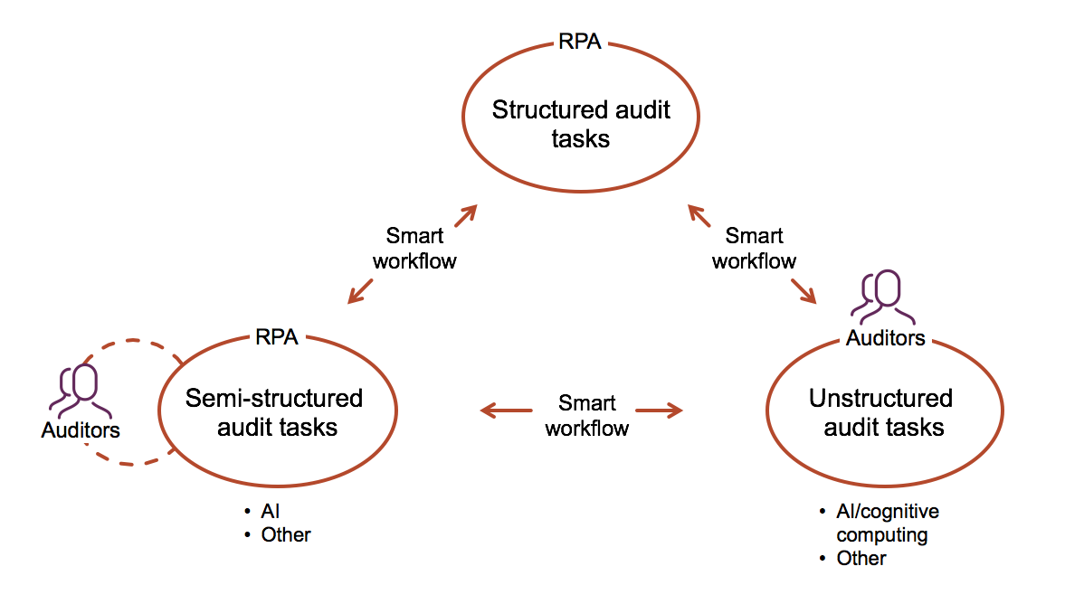
The “Auditor-in-the-Loop” IPA Ecosystem
Notes:
In an audit engagement, IPA will automate different types of audit tasks in different degrees. Orchestrated by the smart workflow, in which some complicated and fuzzy rules can be learned through time.

Slide 14
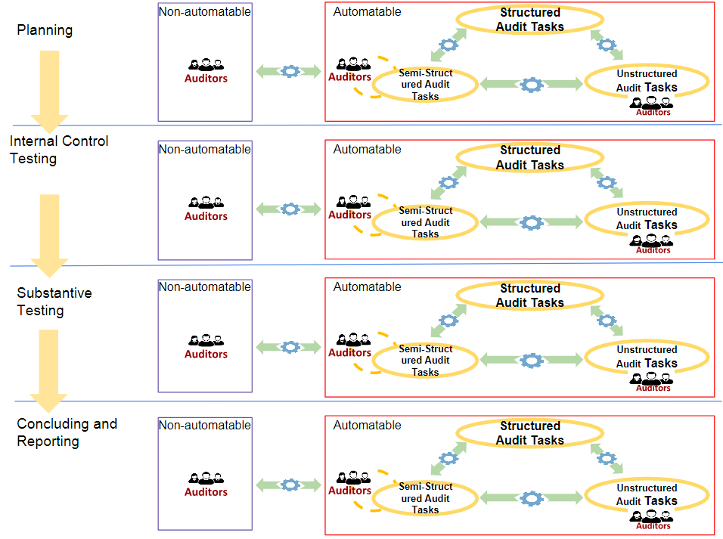
The Audit Workflow Driven by IPA
Smart workflow
Smart workflow
Smart workflow
Notes:
In each major audit phase, the results of previous phase are transmitted to the next, leading to an audit workflow driven by IPA and in which the tasks are orchestrated by the smart workflow.

Slide 15
Framework of Implementing IPA in Audit
1. Process understanding
2. Process redesign
3. Process modularization
6. IPA prototype testing and modification
5. Process orchestration
4. Process automation
PPA/RPA
Algorithm training and testing
Notes:
HP example.

Slide 16
IPA Facilitates Continuous Audit
IPA to facilitate CA in external audit
IPA is non-invasive, so the data acquisition in real time is expected to be easier and to get less resistance from the client.
IPA provides new opportunities for the existing manual work in external audits to be automated
The automation facilitated by IPA provides chances for external audits to be conducted more timely
IPA to mitigate the independence issue of CA
IPA can interact with the client system from the presentation layer
The auditors can build the CA layer on top of the client system in a non-invasive way and can be separated from manager’s monitoring system, enhancing the independence of the auditors.
Notes:
and the audit workflow driven by IPA can be extremely helpful for external audits in coordinating and controlling their audit processes, increasing the efficiency and effectiveness of each engagement

Slide 17
Conclusion
IPA could achieve flexible, scalable, and intelligent process automation in audit.
Auditors’ work will be further shifted to the part that needs their professional judgement.
IPA could enhance the efficiency and effectiveness of audit
IPA could facilitate continuous audit

Slide 18
Please contact me at: abigail.zhang@rutgers.edu
“If we knew what it was we were doing, it would not be called research, would it?”
-Albert Einstein

